Slide 1
INVESTMENT CASE STUDY SUBMISSION
- Vipul Narain

Slide 2
Spark Fund Investment Case Study based on Global trends
Investing money is an art and always investment should be rational, sensible, quantified, logical etc. Spark Funds is an asset management fund and want to invest in few companies by identifying the best sector, country and suitable investment Type. In this project based on my understanding, details and data provided, I have come out with the solution of where to actually invest money based on some constraint provided by Spark funds.
Here I applied CRISP-DM framework in order to select best sector and country. Steps Involved are : -
Business Understanding
Data Understanding
Data Preparation
Data Modelling
Model evaluation
Model Deployment

Slide 3
Investment Strategy Process
Business Understanding
Data Analysis
Data Preparation
Data Modelling
Model evaluation/ Deployment
Company details
Funding round details
Sector Classification
Involved merging of all the files (master_frame)and cleaning of data.
(Iterative Process until data cleans)
Modelling Methods
K mean
Partial
Hierarchical
Association algorithms for modeling
Evaluation to ensure that the model is robust and effective
Understanding the business objective and data gathering
Deployment of a solution
Need to understand the data present in different files after reading the data and creating the data frames.
Data Preparation by structuring, cleaning and merging of data
Modelling the data so that it should sound efficient and easy to use.

Slide 4
Funding types analysis
In order to understand Companies and Round Dataset first we need to fetch the unique key and based on that need to understand the common companies and corresponding data to it. Now we need to merge those Dataset as one Dataset based on the unique key. From merge table calculated investment across all fund types:
This table clearly says that based on our conditions best Funding Round Type to invest is Venture.
funding_round_type | raised_amount_usd
angel | 958,892
convertible_note | 1,457,327
debt_financing | 17,043,526
equity_crowdfunding | 539,113
grant | 4,312,660
non_equity_assistance | 411,203
post_ipo_debt | 168,704,572
post_ipo_equity | 82,182,494
private_equity | 73,341,462
product_crowdfunding | 1,363,131
secondary_market | 79,649,630
seed | 719,892
undisclosed | 19,252,764
venture | 11,749,431

Slide 5
Country Analysis
Here we analysed top3 English speaking countries for the type of investment suited i.e. Venture. Analysis of the countries is based on with the highest amount of funding for the chosen investment type.
Based on the above data it is clear to us that need to invest most of our amount in top sector of these countries.
Country Code | Raise Amount USD(In billion)
USA | 422.5
GBR | 20.25
IND | 14.39

Slide 6
Sector and Company analysis
Based on the investment type and top countries, below are the top sectors and their respective companies where the investment can be made. In order to do that first we need to melt the mapping sheet and merge with out merged Dataset of companies and round2 tables.
Main Sectors | United States of America |  | Great Britain |  | India
 | Total number of Investments (count) | Total amount of investment (USD) | Total number of Investments (count) | Total amount of investment (USD) | Total number of Investments (count) | Total amount of investment (USD)
Automotive & Sports | 167 | $1,454,104,361.00 | 16 | $167,051,565.00 | 13 | $136,900,000.00
Cleantech / Semiconductors | 2300 | $21,206,628,192.00 | 128 | $1,150,139,665.00 | 20 | $165,380,000.00
Entertainment | 591 | $5,099,197,982.00 | 56 | $482,784,687.00 | 33 | $280,830,000.00
Health | 909 | $8,211,859,357.00 | 24 | $214,537,510.00 | 19 | $167,740,000.00
Manufacturing | 799 | $7,258,553,378.00 | 42 | $361,940,335.00 | 21 | $200,900,000.00
News, Search and Messaging | 1582 | $13,959,567,428.00 | 73 | $615,746,235.00 | 52 | $433,834,545.00
Others | 2950 | $26,321,007,002.00 | 147 | $1,283,624,289.00 | 110 | $1,013,409,507.00
Social, Finance, Analytics, Advertising | 2714 | $23,807,376,964.00 | 133 | $1,089,404,014.00 | 60 | $550,549,550.00

Slide 7
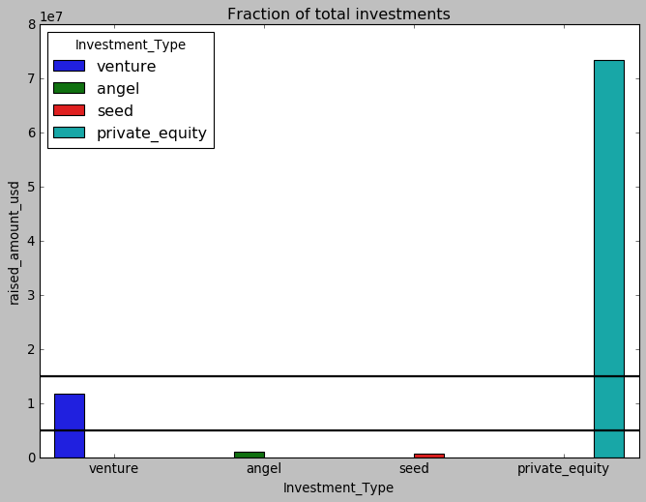
Best Funding type against raised Amount

Slide 8
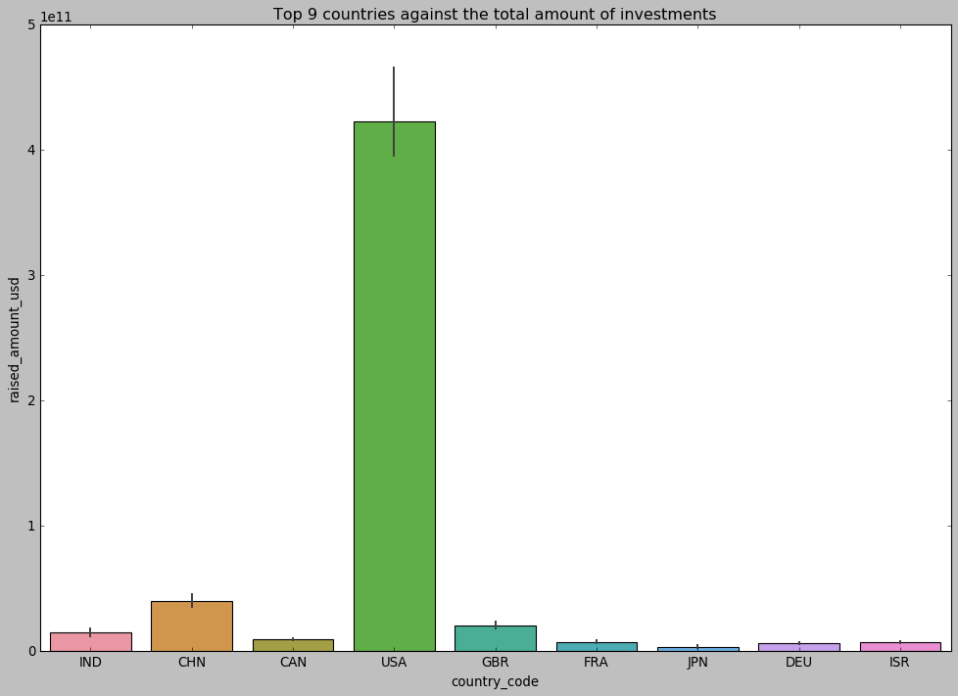
Top 9 Countries against total amount invested

Slide 9
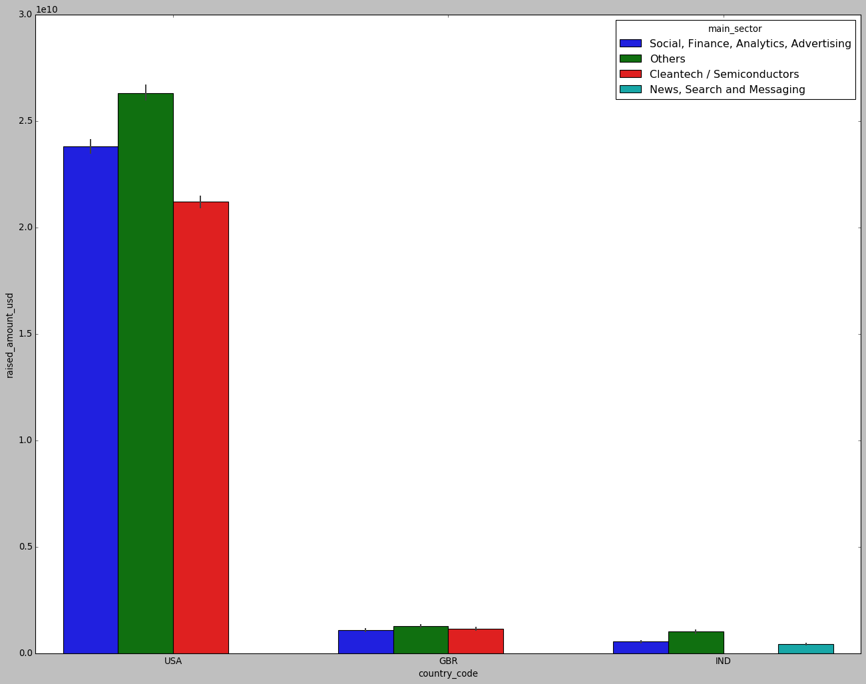
Number of investments in the top 3 sectors of the top 3 countries

Slide 10
Conclusion
Based on the understanding of data and graphs it is clear that USA is the best country to make investment, United Kingdom comes after that to make investment and India is on third place.
As we have a amount Spark funds wants to invest is between 5 to 15 million USD per round. We can split our investments based on sectors and English speaking countries.
Attest 60% of the amount can be invested in USA on top 3 sectors among top 2 companies that are :
Virtustream
SST Inc. (Formerly ShotSpotter)
Around 40% of the amount can be distributed and can be invested in Great Britain and India on there top sectors and on companies received highest investment :
Electric Cloud - Can invest around 20% of the total amount.
Celltick Technologies - Can invest around 10% of the total amount.
FirstCry.com - Can invest 7% of the total amount.
GupShup - Can invest 3% of the total amount.

